Slide 1
Workshop on: Working with API and Json in Flutter
By Poshan Pandey

Slide 2

By Poshan Pandey

Slide 3
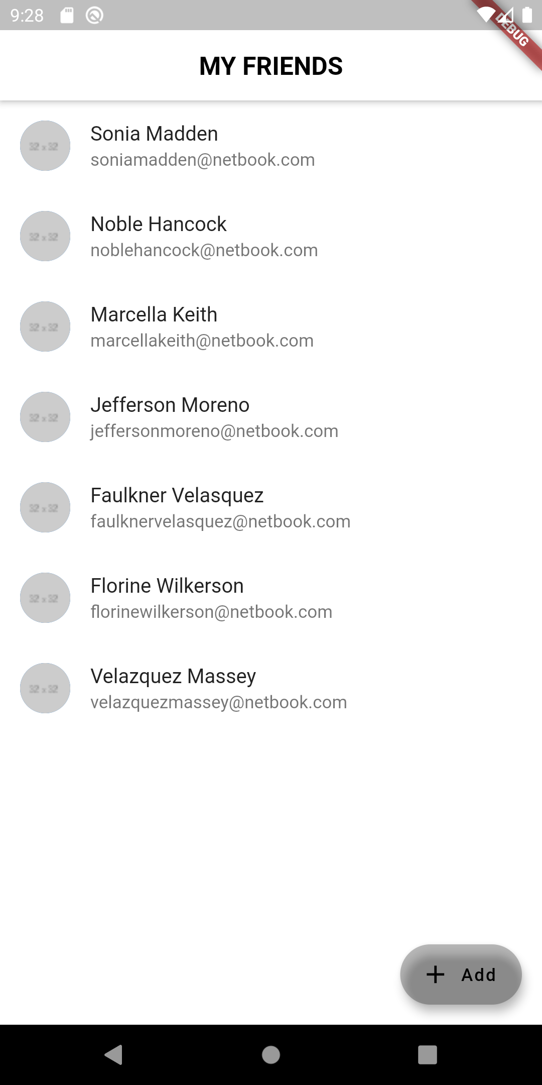
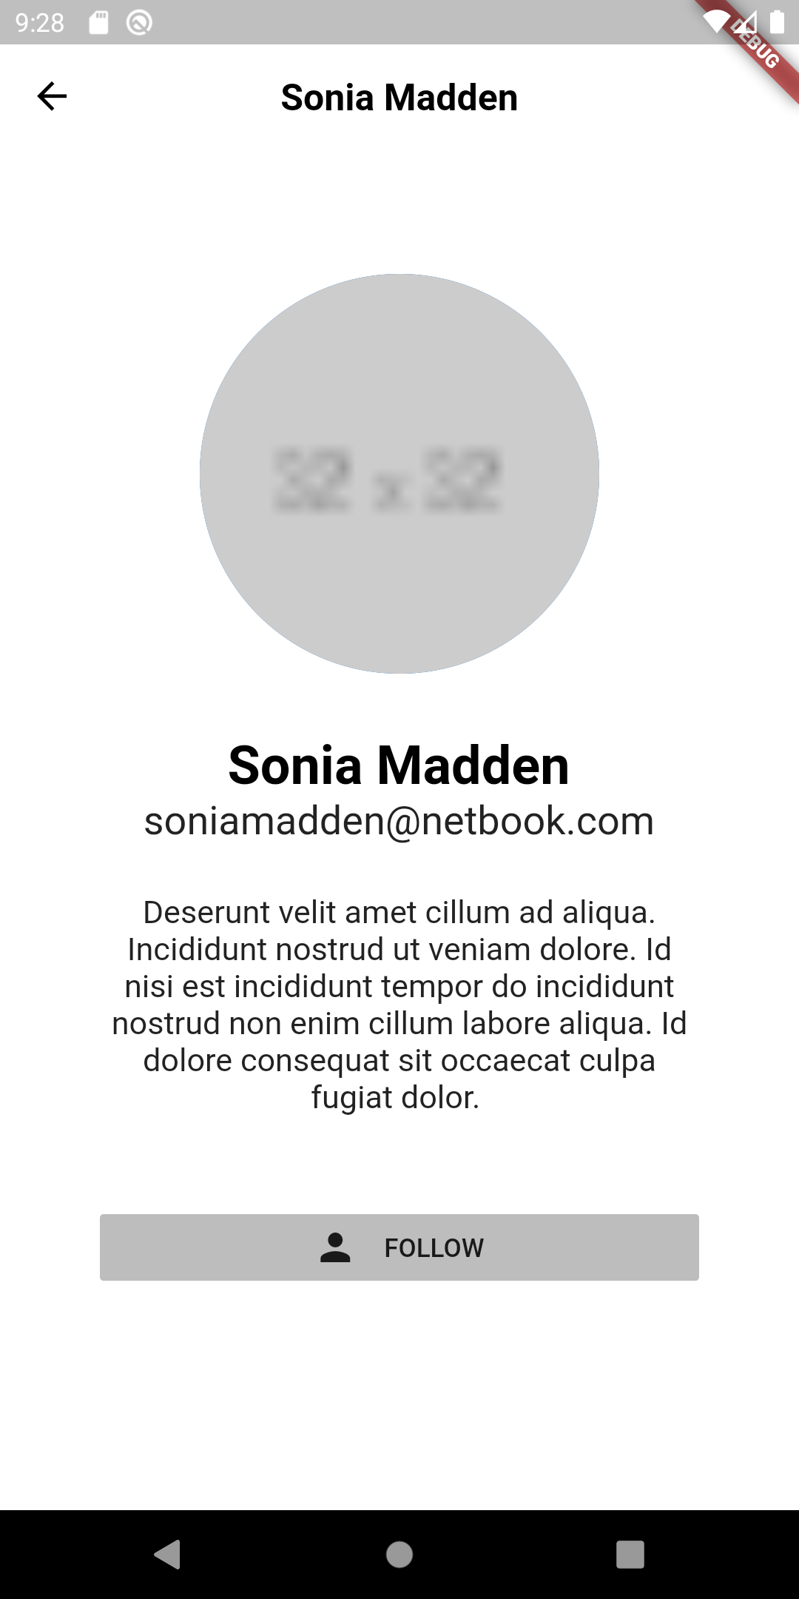
What will we cook?
By Poshan Pandey

Slide 4
Asynchronous programming
Futures
Async
Await
By Poshan Pandey

Slide 5
Implementing
Future<List<Friends>> _getFriends() async {
var data = await http .get("http://www.json-generator.com/api/json/get/cgqDKqTsBK?indent=2");
var friends_data = json.decode(data.body);
List<Friends> friendsList = [];
for (var u in friends_data) {
Friends fr = Friends(u["index"], u["about"], u["email"], u["name"], u["picture"]);
friendsList.add(fr);
}
return friendsList;
}

Slide 6
API

Slide 7
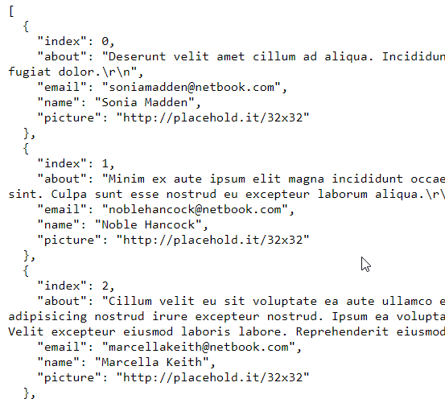
JSON

